Slide 1
What are the key stage 4 qualifications?
Information about Year 10 and 11

Slide 2
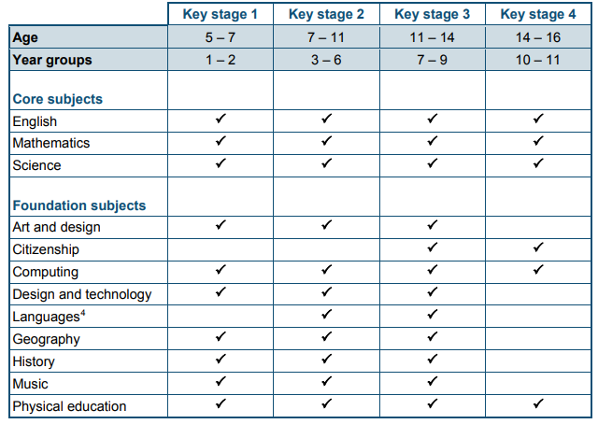
The national curriculum KS3
Maintained schools in England are legally required to follow the statutory national curriculum
The national curriculum provides pupils with an introduction to the essential knowledge that they need to be educated citizens
Religious Education is also a Core subject
The curriculum offer is broad and balanced, all year 9 students study the core and foundation subjects with Performing Arts as an addition

Slide 3
The national curriculum KS4
In Year 10 and 11 all students study; English, Mathematics, Science and Religious Education
Physical Education is once a fortnight
Citizenship and Computing are delivered through the PSHE programme
All students will select 3 further subjects to study

Slide 4
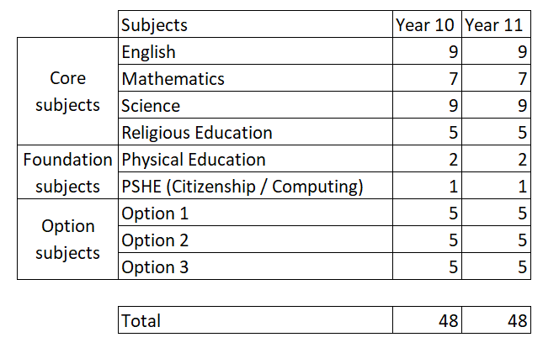
Year 10 and 11 lessons
Each student will have 48 hours of lessons a fortnight
Each option subject will be 5 hours a fortnight, approximately 180 hours per subject over two academic years (5 ½ terms)

Slide 5
Key stage 4 entitlement areas
arts (comprising art and design, music, dance, drama and media arts)
design and technology
the humanities (comprising geography and history)
modern foreign language
The NC states that “schools must provide access to a minimum of one course in each of the four entitlement areas”
Christ the King College offered all courses listed above

Slide 6
What is a GCSE qualification?
The General Certificate of Secondary Education (GCSE) is an academic qualification in a particular subject, taken in England, Wales and Northern Ireland
The UK government has drawn up a list of preferred subjects known as the English Baccalaureate and the Progress 8 benchmark metric is calculated on the results in eight GCSEs including Maths and English.

Slide 7
What is a vocational qualification?
Vocational qualifications are practical qualifications that relate to a specific job or career sector
They combine a mix of theory and practical learning and students may do some work experience too
BTEC - Business and Technology Education Council qualifications (BTECs) have been around for over 30 years and are designed to give you the skills that businesses are looking for
OCR Cambridge Nationals - Cambridge Nationals have been around since 2012 and are designed for students aged 14-16. They are linked to different industries, and geared to the requirements of each career sector. They take the same amount of time as GCSEs

Slide 8
GCSE - How will I be assessed and graded?
GCSEs are awarded on a graded scale, and cross two levels of the Regulated Qualifications Framework (RQF) Level 1 and Level 2
Level 1 qualifications constitute GCSEs at grades 1, 2, and 3
Level 2 qualifications are those at grades 4, 5, 6, 7, 8, and 9

Slide 9
Vocational - How will I be assessed and graded?
Typically vocational qualifications are graded using “Pass”, “Merit” or “Distinction” but may also include “Level 1” or “Level 2”.

